Slide 1


CURRENCY EXCHANGE RATE ANALYSIS
STUDENT NAME :YUVARAJA . K REGISTER NO
:312207460
DEPARTMENT
:B.COM(GENERAL)
COLLEGE :C.KANDASWAMI
NAIDU COLLEGE
FOR MEN

Slide 2


PROJECT TITLE
CURRENCY EXCHANGE RATE ANAYSIS

Slide 3
AGENDA
1.INTRODUCTION TO EXCHANGE RATE 2.IMPORTANCE OF EXCHANGE RATE 3.FACTORS INFLUENCING EXCHANGE RATE 4.TYPES OF EXCHANGE RATE SYSTEM 5.FORECASTING TECHNIQUES 6.GLOBAL EVENTS AND EXCHANGE RATE 7.CURRENCY RISK MANAGEMENT 8.ETHICAL CONSIDERATION
9.FUTURE TRENDS IN EXCHANGE RATE 10.TOOLS FOR DECISION MAKING 11.CONCLUSION AND TAKEAWAYS

Slide 4

Introduction to Exchange Rates
In this presentation, we will explore strategic insights into forecasted exchange rate projections. Understanding these projections is crucial for informed decision-making in ﬁnancial markets and international trade.

Slide 5
Importance of Exchange Rates
Exchange rates signiﬁcantly impact trade balances, inﬂation, and economic growth. Monitoring these rates helps businesses to make strategic decisions regarding pricing, sourcing, and market entry.

Slide 6
Factors Influencing Exchange Rates
Several factors inﬂuence exchange rates, including interest rates, inﬂation rates, and political stability. Understanding these factors is essential for predicting future movements and trends.

Slide 7

Types of Exchange Rate Systems
Exchange rates can be classiﬁed into ﬁxed, ﬂoating, and pegged systems. Each system has its own implications for monetary policy and economic stability.

Slide 8
Forecasting Techniques
Forecasting exchange rates involves various techniques such as technical analysis, fundamental analysis, and econometric models. Each method provides unique insights into potential market movements.

Slide 9

Global Events and Exchange Rates
Global events, including political elections, natural disasters, and trade agreements, can drastically aﬀect exchange rates. Staying informed about these events is vital for eﬀective decision-making.

Slide 10

Currency Risk Management
Eﬀective currency risk management strategies, such as hedging and diversiﬁcation, are essential for businesses operating internationally. These strategies help mitigate potential losses due to exchange rate ﬂuctuations.

Slide 11

Ethical Considerations
Ethical considerations in exchange rate forecasting include transparency and responsible reporting. Ensuring ethical practices builds trust and credibility in ﬁnancial markets.

Slide 12

Future Trends in Exchange Rates
Future trends in exchange rates will likely be inﬂuenced by digital currencies, globalization, and economic shifts. Staying ahead of these trends is essential for strategic planning.

Slide 13
Tools for Decision-Making
Utilizing various tools, such as forex platforms and analytical software, can enhance decision-making. These tools provide real-time data and analytics for informed strategies.

Slide 14
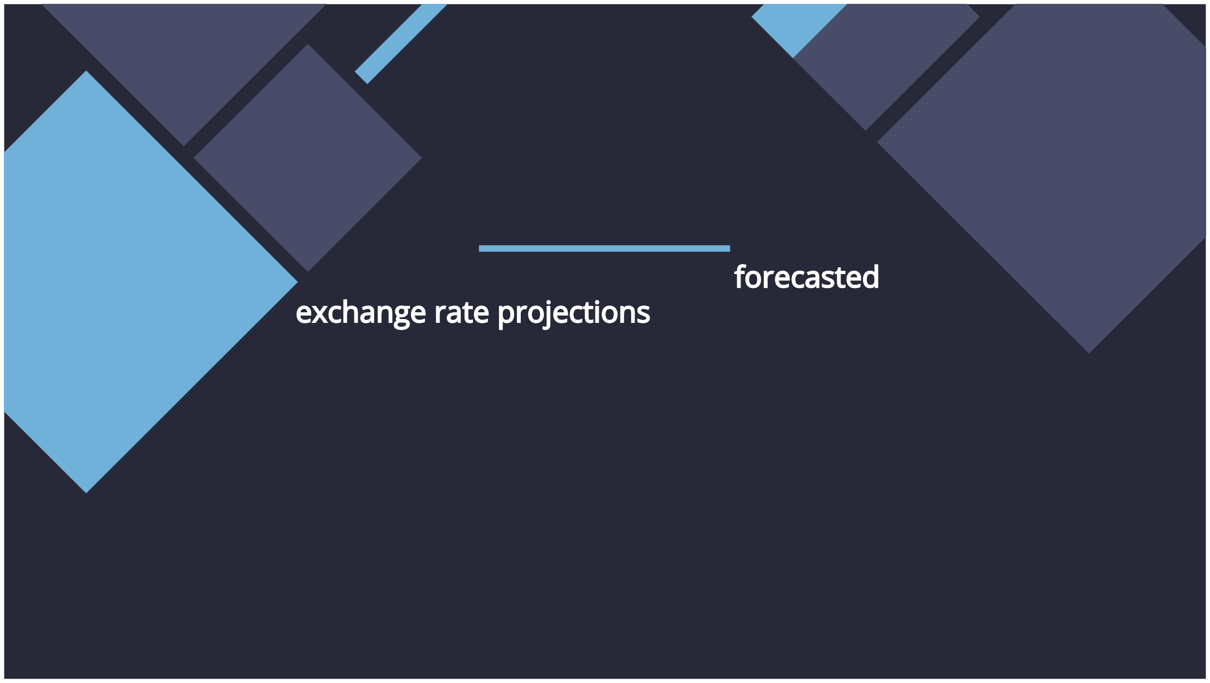
Conclusion and Takeaways
In conclusion, understanding forecasted exchange rate projections is vital for eﬀective decision-making. By leveraging insights from various factors, businesses can navigate the complexities of global ﬁnance.

Slide 15
Thanks!

